Slide 1
Introduction to Operating Systems

Slide 2
What is Operating System?
A System Software
It acts as an interface between a computer user and computer hardware.
Manages and controls the hardware and software resources of a computer system
Provide a common platform for software applications to run on and enable users to interact with the computer system.

Slide 3
Computer System structure
The following are the main components of a computer structure
Hardware
The physical components of a computer system, such as the central processing unit (CPU), memory, storage devices, input devices (keyboard, mouse, etc.), output devices (monitor, printer, etc.), and communication devices (network cards, modems, etc.).
Operating System
Controls and coordinates the use of the hardware among various applications and users
Application software
Is a type of computer software that is designed to perform specific tasks or functions for end-users.
Eg: Word processing software, Web browser, gaming software etc.

Slide 4
Components of a Computer System(Contd..)
Firmware
Specialized software that is stored in non-volatile memory on specific hardware components, such as the BIOS or firmware on a network card.
Data
The information that is processed and stored by the computer system.
This can include text, images, audio, video, and other types of data.
Users
The people who interact with the computer system, providing input and receiving the output.

Slide 5
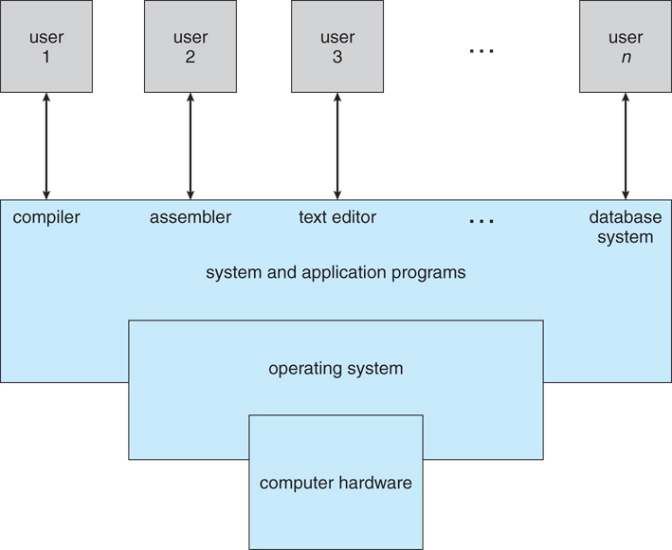
Abstract view of a computer system

Slide 6
Definition of OS
OS is a Resource Allocator
The operating system (OS) is the fundamental software that manages computer hardware resources and provides services to application software.
OS is a Control Program
It is responsible for controlling and coordinating computer system activities, including hardware, software, and user interactions.

Slide 7
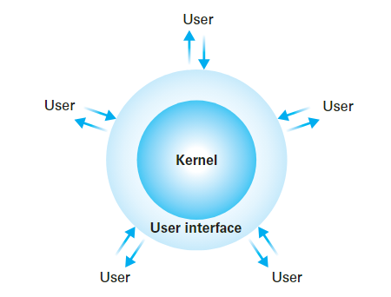
Components of os
Shell
Kernal

Slide 8
shell
Shells provide a way for the user to communicate with the operating system.
It is the outer layer of the operating system.
The shell interprets user commands and translates them into instructions that the kernel can execute through System Calls
Shell is broadly classified into two categories
Command Line Shell
Graphical Shell (GUI)

Slide 9
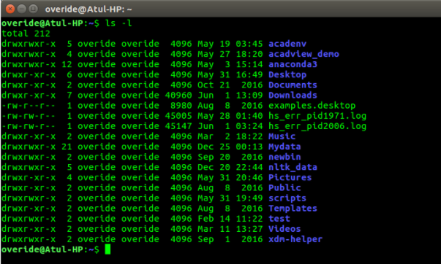
Command Line Shell
Communicates with users through commands, interactively
Eg:-
Terminal in Linux
Command prompt in windows

Slide 10
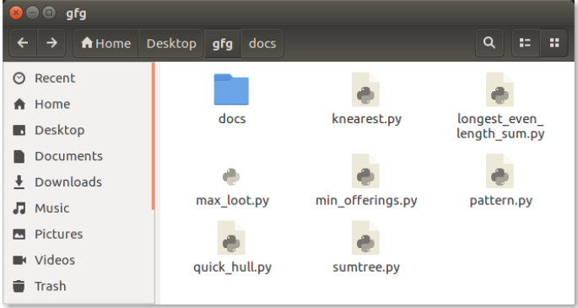
Graphical Shell
Also known as Graphical User Interface (GUI) shell
It allows users to interact with the system through graphical icons
Users can issue commands by manipulating these icons with a mouse by pointing and clicking

Slide 11
kernal
The kernel is the core component of an operating system that manages the system's hardware and software resources and provides services to other programs that run on top of it.
The kernel contains those software components that perform the very fundamental functions of a computer like
Process Management
Memory Management
File Management
Disk Management
I/O Management

Slide 12
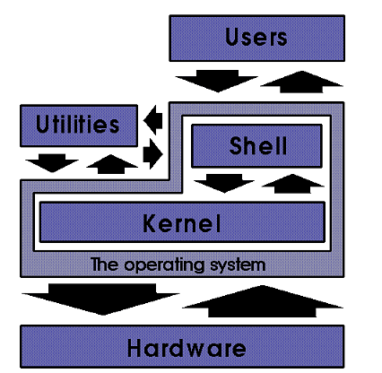
Components of os: overview

Slide 13
Modes of OS operation
Dual Mode operation
User Mode: Non-Privileged Mode operation that restricts the processes’ access to the system resources
Kernal Mode: Privileged Mode operation that allows access to all system resources. Device drivers, system services, and critical operating system components execute in kernel mode.
Mode Bit :
The mode bit is a hardware flag (a single bit in the processor's control register) that indicates whether a processor is running in user mode or kernel mode.
It is set or cleared by the operating system.

Slide 14
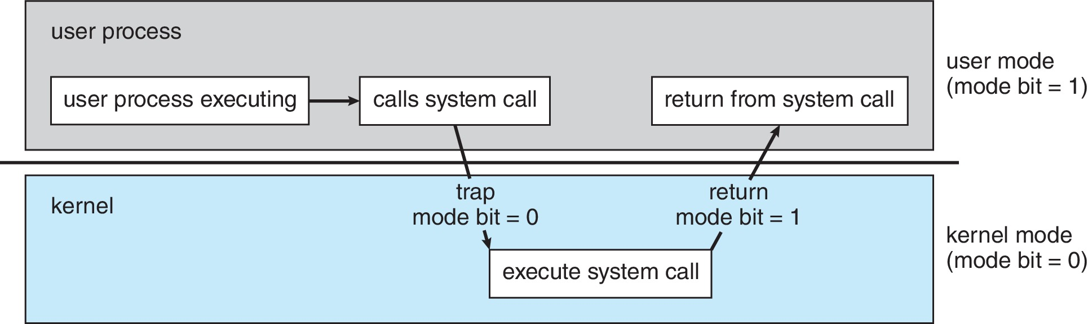
Dual mode operation

Slide 15
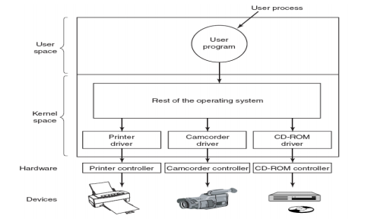
Interaction with hardware

Slide 16
Device drivers and device controllers
Device Controllers:
Device controllers are physical components that are responsible for controlling and managing hardware devices such as hard drives, network cards, and sound cards.
They are typically integrated into the hardware device itself and communicate directly with the operating system to manage the device.
Device controllers translate the signals from the operating system into commands that the device can understand and execute.
Device Drivers:
Device drivers are software programs that act as an interface between the device controller and the operating system.
They provide the operating system with the necessary instructions to communicate with the device controller and use the hardware device.
Device drivers are specific to the device they manage and are usually provided by the manufacturer of the device.
Device drivers are loaded into the operating system's memory when the device is connected to the computer and are used to facilitate communication between the operating system and the device controller.

Slide 17
Functions of OS
Some of the main functions of an operating system are:
User Interface Management
Resource Management
Process Management
Memory Management
File Management
Security Management
Device Management

Slide 18
Functions of OS (Contd..)
User Interface Management:
The operating system provides a user interface to interact with the computer system.
It provides graphical user interfaces (GUIs) or command-line interfaces (CLIs) to enable users to interact with the system, run programs, and access files.
Resource Management:
The operating system manages computer hardware resources, such as CPU time, memory, storage, and input/output devices, to ensure efficient and effective utilization of resources.
It allocates these resources to processes and programs, schedules tasks, and prioritizes them based on their importance.

Slide 19
Functions of OS (Contd..)
Process Management:
The operating system manages processes or tasks running on a computer system.
It creates and terminates processes, schedules them, and provides inter-process communication mechanisms to enable them to communicate and synchronize with each other.
Memory Management:
The operating system manages memory resources, ensuring that programs and processes have enough memory to run effectively.
It allocates memory to processes and programs and manages memory paging, swapping, and fragmentation.

Slide 20
Functions of OS (Contd..)
File Management:
The operating system manages file resources, including file creation, deletion, and modification, as well as access control and sharing.
It provides a hierarchical directory structure and file naming conventions to organize and manage files.
Security Management:
The operating system provides security mechanisms to protect computer systems and user data.
It manages user accounts, permissions, and access control, and provides authentication and encryption services to ensure data privacy and integrity

Slide 21
Summary
What is OS?
Computer System Structure
Components of OS
Dual Modes of Operation
Functions of OS

